Slide 1
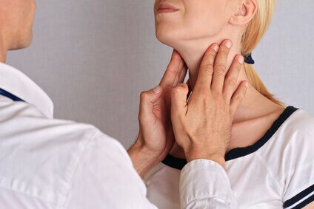
Inspection + palpation

Slide 2
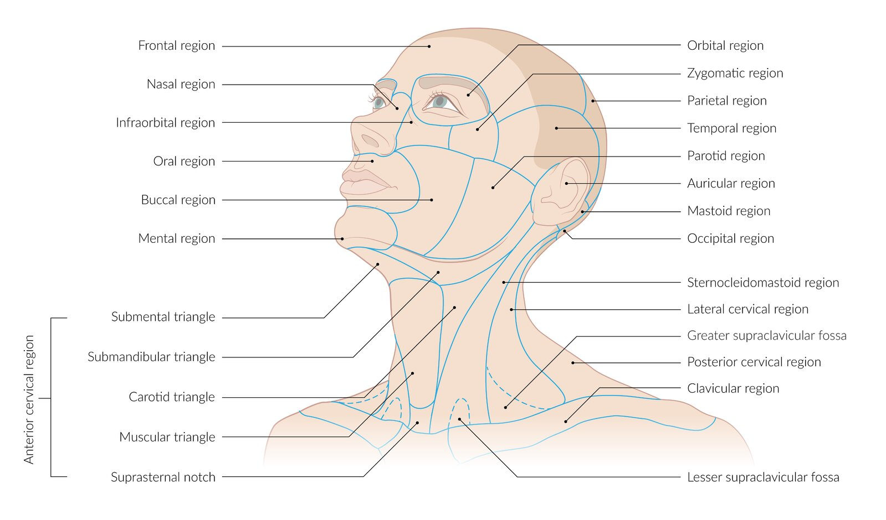

Slide 3
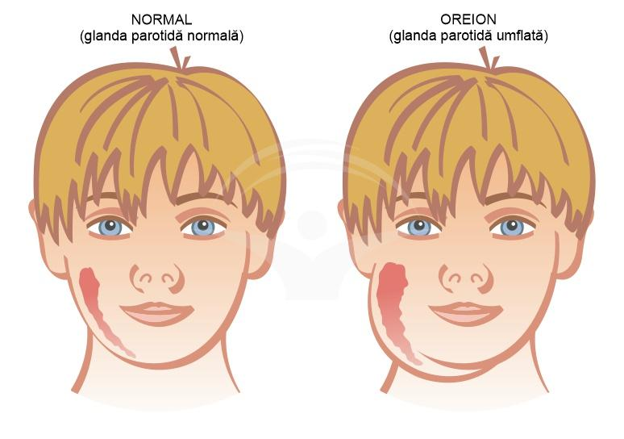
Inspection of the head and neck
Facial Symmetry
Deformities
Swellings
Asymmetries
Signs of Infection
Redness
Edema
Fistulas
Scars
Skin Changes
Pallor
Erythema
Cyanosis

Slide 4
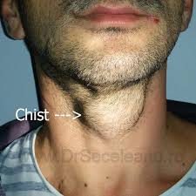
Thyroglossal duct cyst

Slide 5
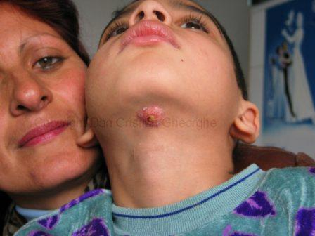
Thyroglossal duct fistula

Slide 6
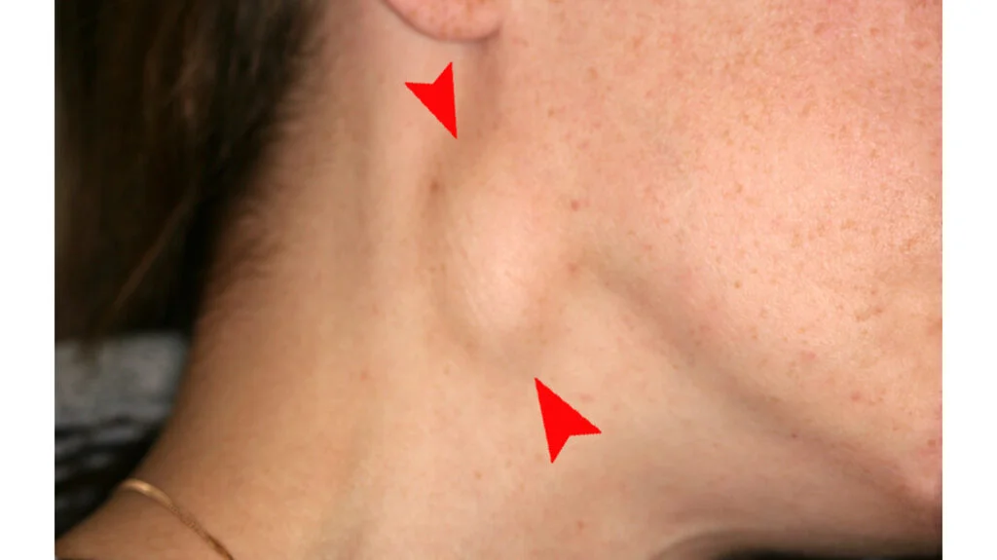
Inflamed lymph node

Slide 7
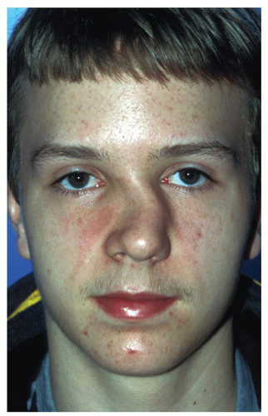
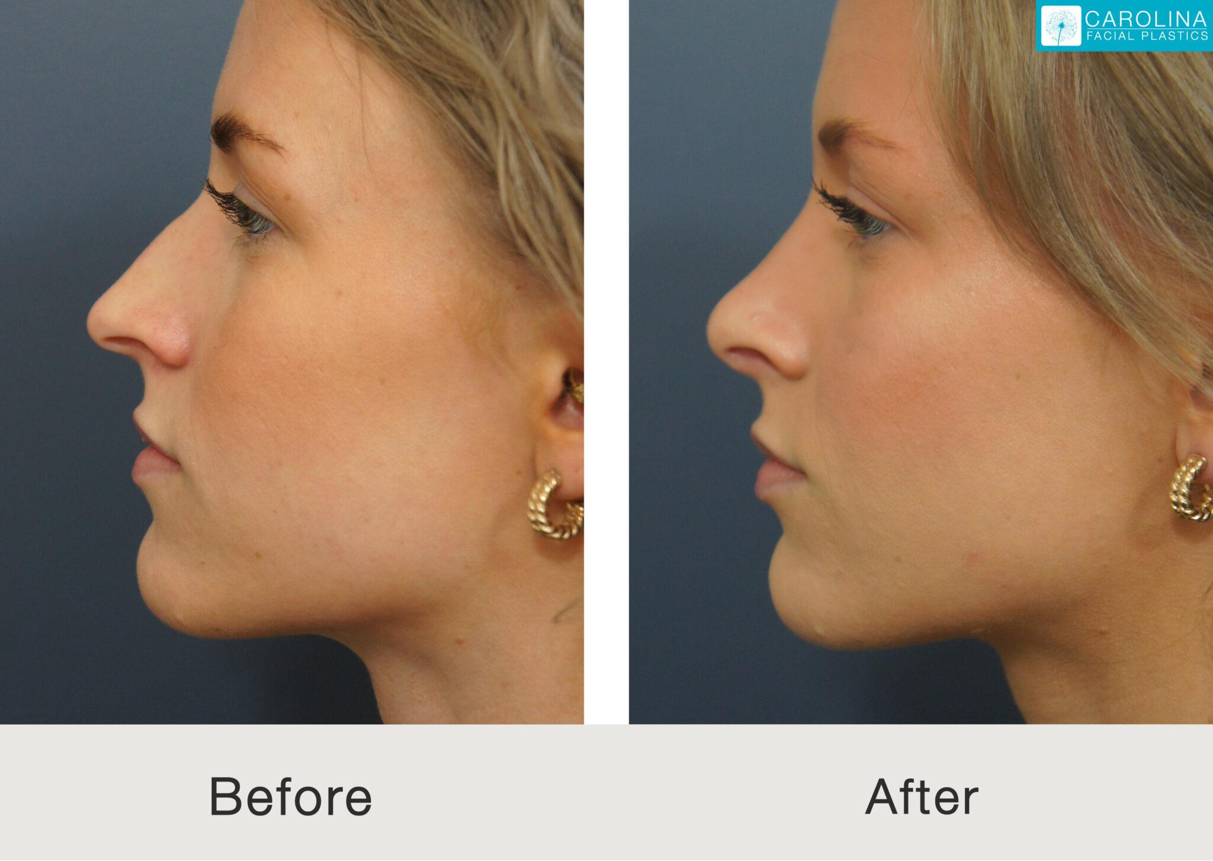
Inspection of the nose and nasal cavities
Deformities, deviations of the nasal pyramid, edema, skin lesions

Slide 8
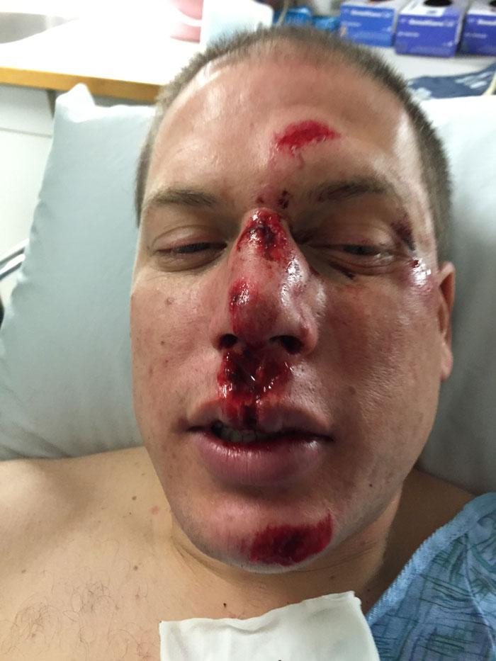
Nasal pyramid trauma

Slide 9
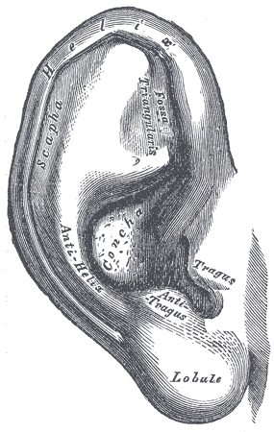
Inscpetion of the concha
Observation of shape and symmetry
Assessment of size and position
Examination of the skin
Detection of lesions or inflammation
Presence of secretions or crusts
Retroauricular inspection

Slide 10
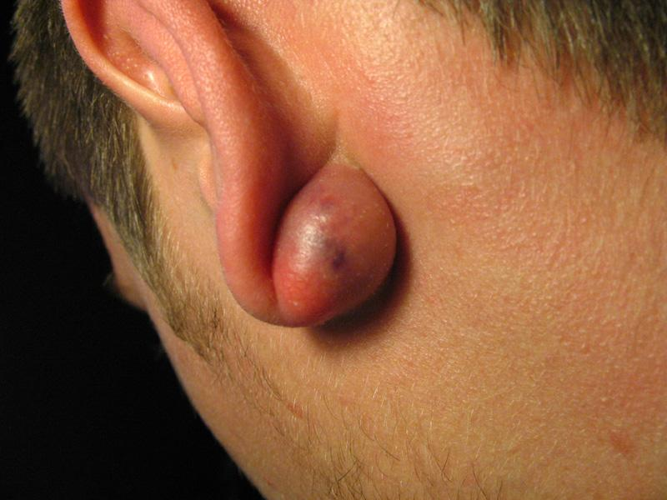
Retroauricular cyst

Slide 11
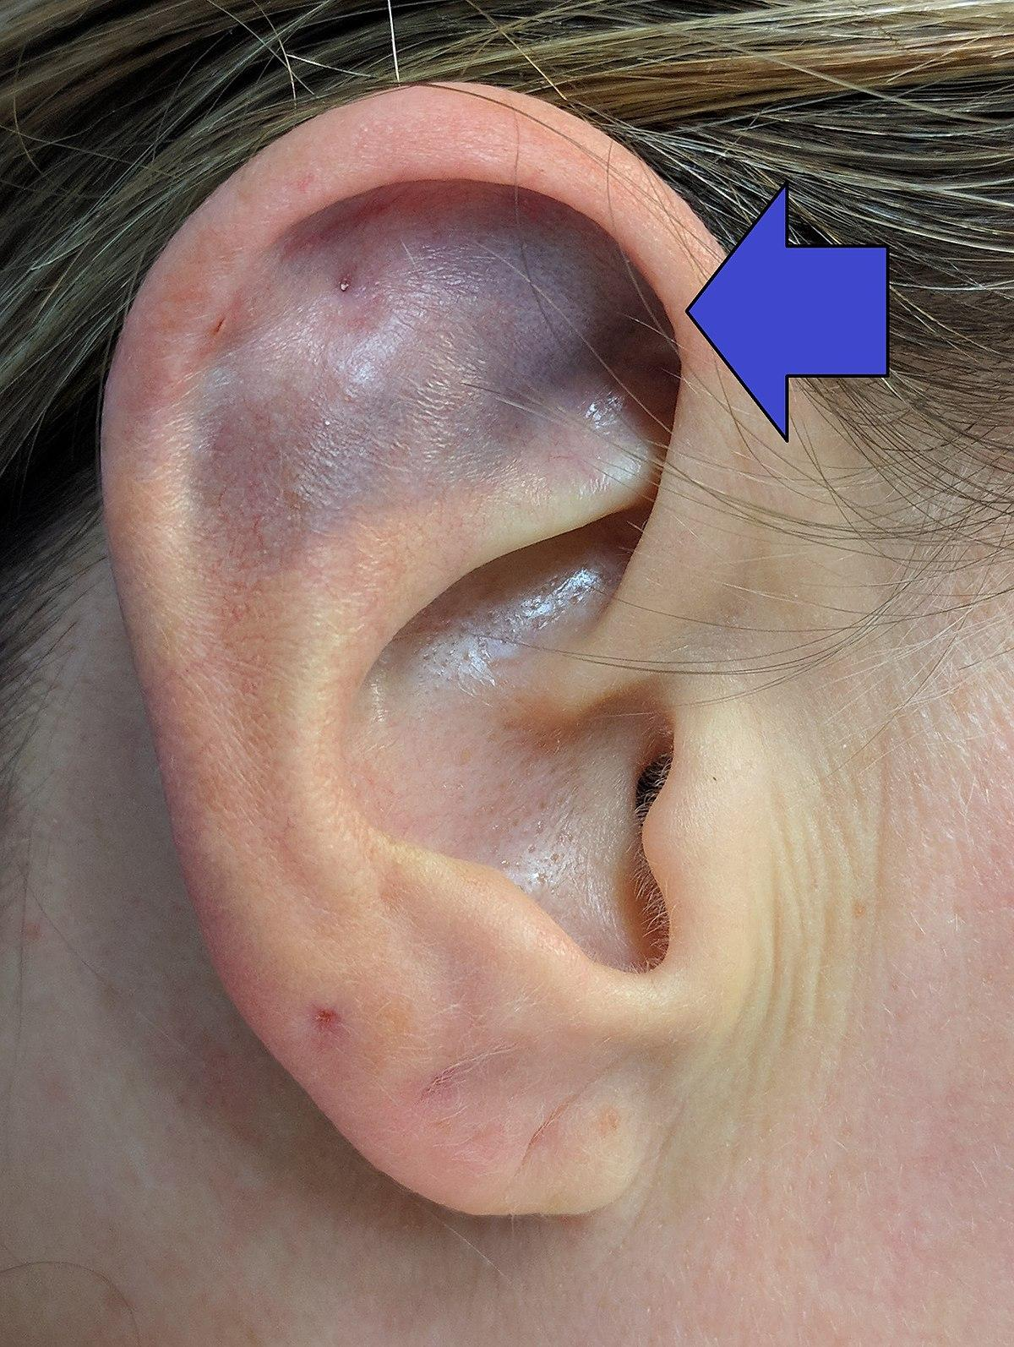
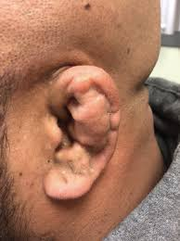
Othematoma

Slide 12
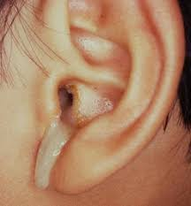
Otorrhea

Slide 13
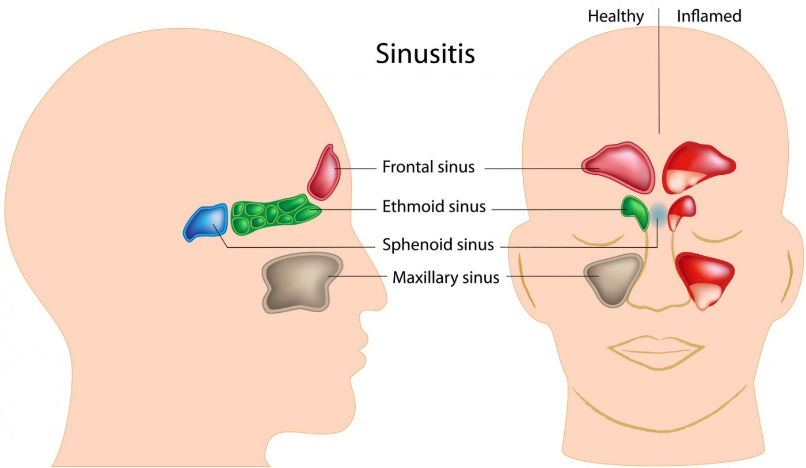
Palpation of the sinus points

Slide 14
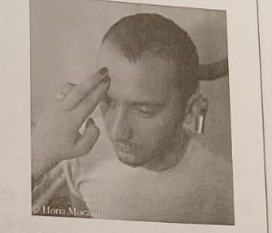
Using the index and middle fingers, gentle palpation and percussion of the frontal sinuses is performed
At the level of the forehead (anterior wall of the frontal sinus).

Slide 15

At the level of the superomedial angle of the orbit.
At the level of the floor of the frontal sinus.

Slide 16
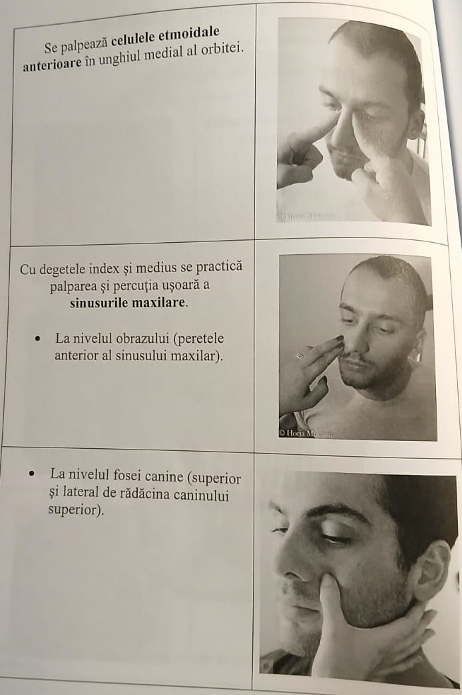
The anterior ethmoidal cells are palpated in the medial angle of the orbit.
Using the index and middle fingers, gentle palpation and percussion of the maxillary sinuses is performed.
At the level of the cheek (anterior wall of the maxillary sinus).
At the level of the canine fossa (superior and lateral to the root of the upper canine).

Slide 17
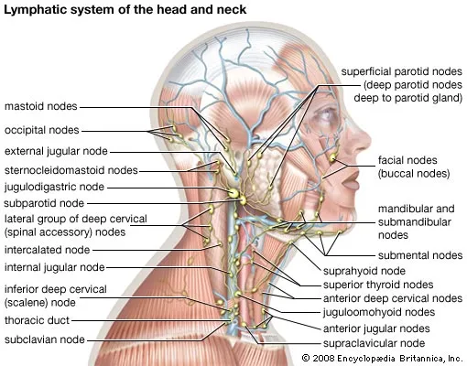
Lymph node palpation

Slide 18
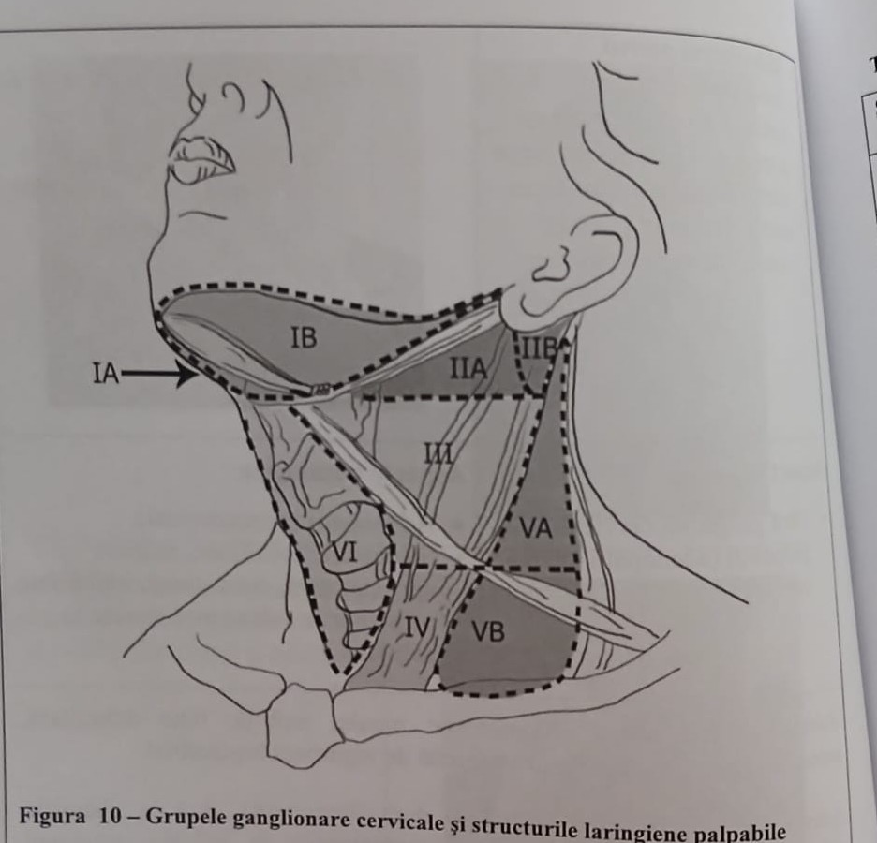
Cervical lymph node levels
IA – submental
IB – submandibular
IIA – upper jugulocarotid
IIB – upper jugulocarotid
III – middle jugulocarotid
IV – lower jugulocarotid
VA – upper spinal
VB – lower spinal
VI – anterior cervical
VII – upper mediastinal

Slide 19
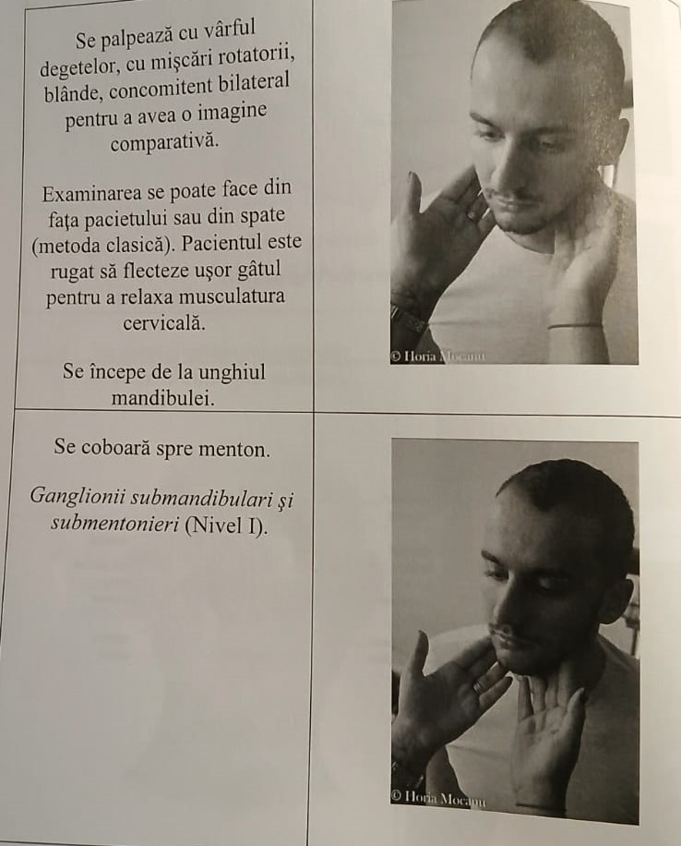
Palpation is done with the fingertips, using gentle, circular movements, bilaterally and simultaneously to allow for comparison.
The examination can be performed from in front of the patient or from behind (classic method). The patient is asked to slightly flex the neck to relax the cervical muscles.
Begin at the angle of the mandible.
Proceed downwards toward the chin.
Submandibular and submental lymph nodes (Level I).

Slide 20
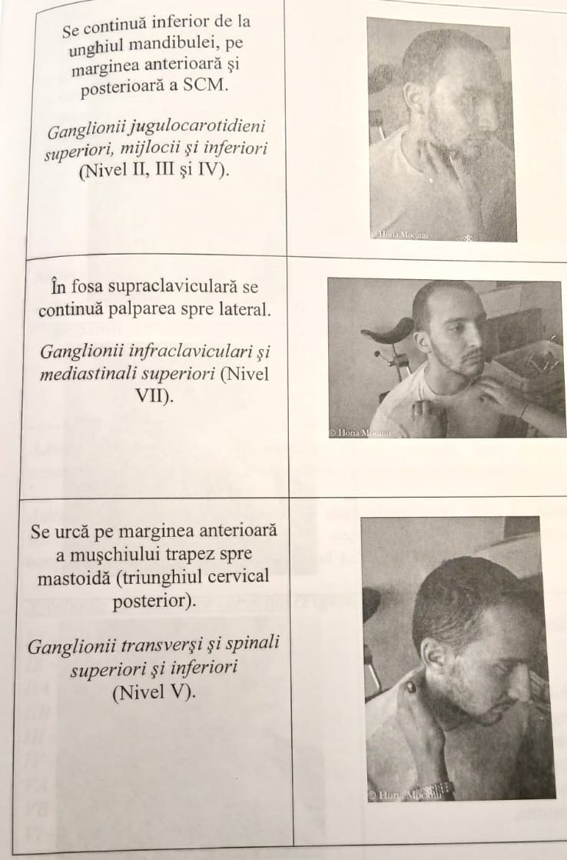
Continue inferiorly from the angle of the mandible along the anterior and posterior borders of the sternocleidomastoid (SCM).
Superior, middle, and inferior jugulocarotid lymph nodes (Levels II, III, and IV).
In the supraclavicular fossa, continue palpation laterally.
Infraclavicular and superior mediastinal lymph nodes (Level VII).
Ascend along the anterior border of the trapezius muscle toward the mastoid (posterior cervical triangle).
Transverse and spinal superior and inferior lymph nodes (Level V).

Slide 21
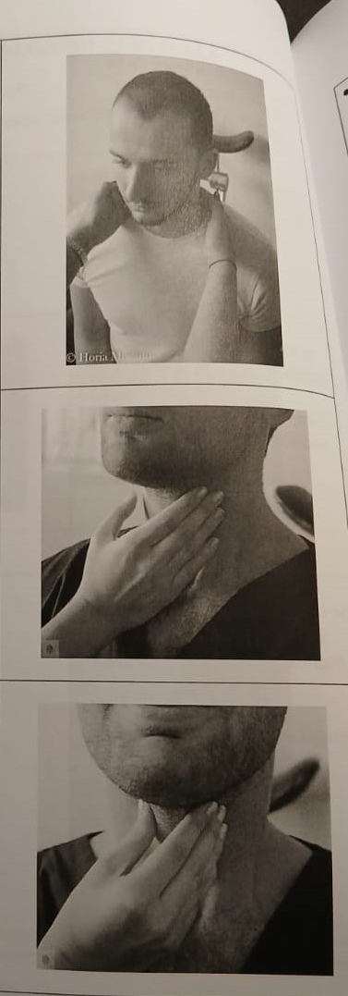
The examination ends with palpation of the nuchal area and the anterior cervical lymph nodes: pre- and paratracheal, precricoid, and perithyroidal (Level VI).
The exam is completed by palpating the thyroid lobes, thyroid cartilage, and cricoid cartilage.
Laryngeal mobility is also tested: Active laryngeal mobility – with fingers placed on the thyroid cartilage, the patient is asked to swallow. Normally, the cartilage will ascend.

Slide 22
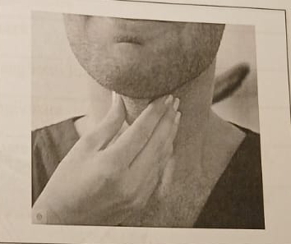
Laryngeal mobility is also assessed:
Active laryngeal mobility – with fingers placed on the thyroid cartilage, the patient is asked to swallow. Normally, the cartilage ascends.
Passive laryngeal mobility – the thyroid cartilage is grasped between the thumb and middle finger and moved laterally. A snapping sound, known as laryngeal crackle, is usually produced.

Slide 23
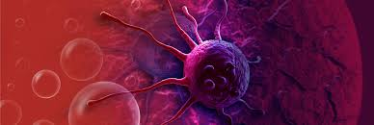
Inflammatory adenopathy: soft, mobile, well-defined, tender to palpation, possibly covered by hyperemic (reddened) skin.
Metastatic adenopathy: hard (wooden), fixed to underlying planes, without clear borders, not painful to palpation, possibly covered by infiltrated skin.

Slide 24
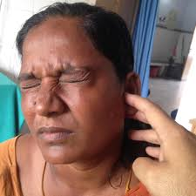
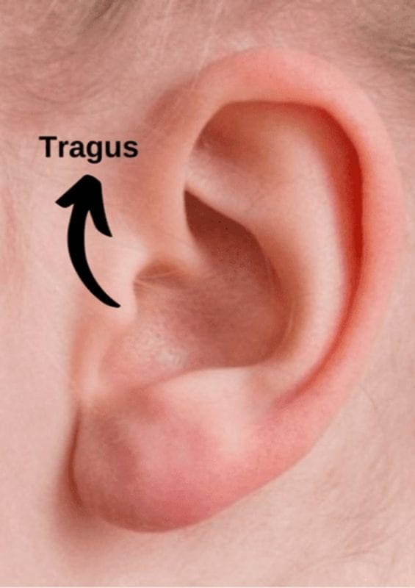
Tragus sign – Otalgia in otitis externa

